Slide 1
The Distributed Deadlock Detection Algorithm
Group 3:
Pooja Baba
Ishu Goyal
Samvidha Reddy Mannem,
Dinesh Kumar Pullepally

Slide 2
About Author
He was worked at Hewlett-Packard Laboratories.
He was mostly active between 1980 and 2000.
Publications: 8
Citations : 48

Slide 3
Motivation
Many algorithms have been published for deadlock detection, prevention, or avoidance in centralized multiprogramming systems
With distributed computing systems, the problem of deadlock reappeared.
  lack of global memory
  message delays

Slide 4
Obermarck’s Algorithm
In Obermarck’s algorithm, the nonlocal portion of the WFG at a site is abstracted by a distinct node, called “external node” or x
A site waits for deadlock-related information (produced in the previous deadlock detection iteration) from other sites.
The site combines the received information with its local WFG graph, detects all cycles, and breaks only cycles that do not contain the external node x

Slide 5
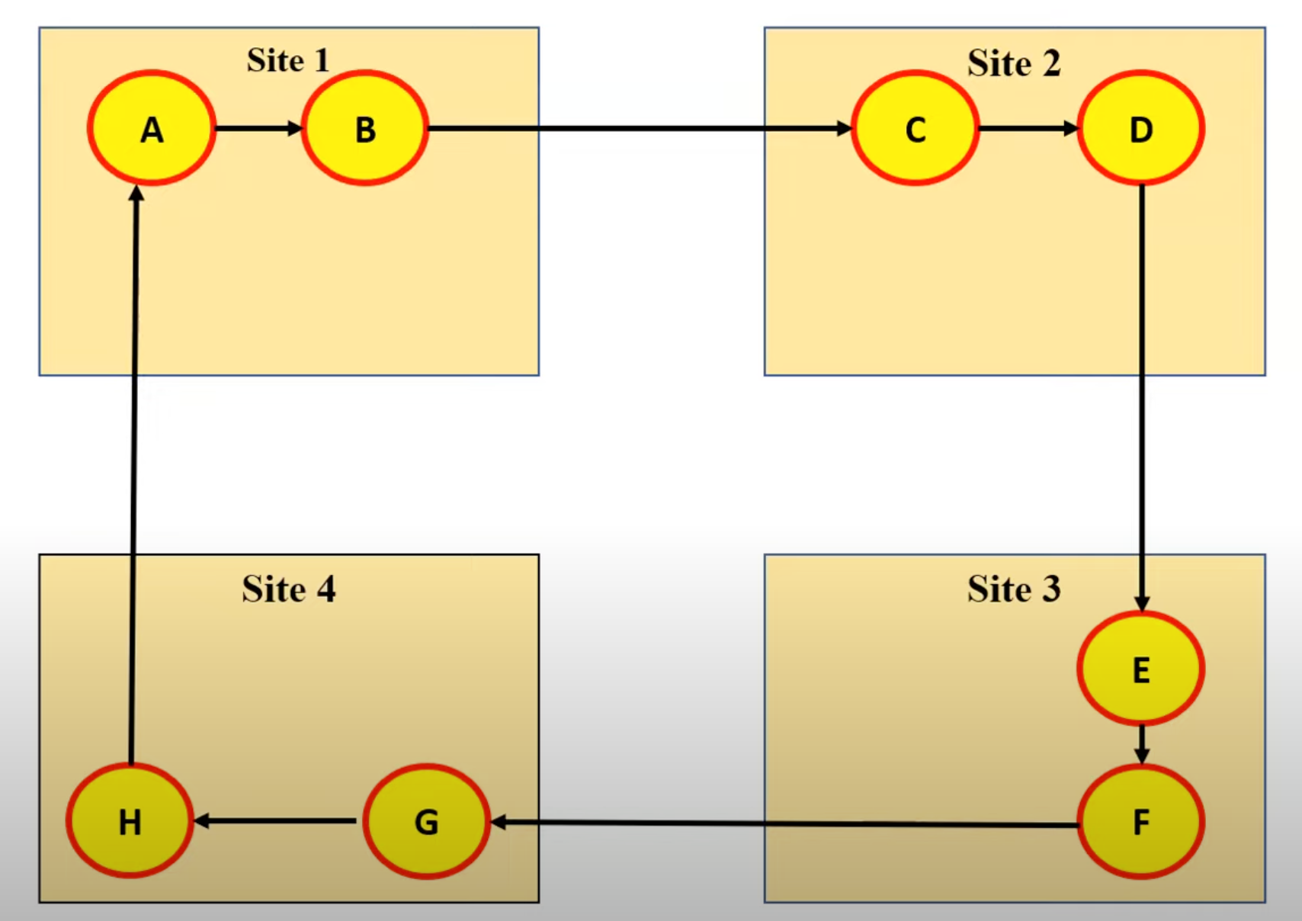

Slide 6
xABx
Level 1
X
X
xGHx
xCDx
X
X
xEFx

Slide 7
xABx
Level 2
X
X
xEFGHx
xABCDx
X
X
xCDEFx

Slide 8
xABx
Level 3
X
X
xCDEFGHx
xABCDx
X
X
xABCDEFx

Slide 9
xABx
Level 4
X
X
xABCDEFGHx
xABCDx
X
X
xABCDEFx

Slide 10
INTRODUCTION
Badal algorithm can be seen as an extension of the deadlock detection algorithm proposed by Obermarck’s algorithm.
It requires fewer messages than other published deadlock detection algorithms
differences from previous algorithms:
  concept of a lock history(transactions) and lock table(resources),
  the notion of intention locks
  a three-staged hierarchical approach to deadlock detection

Slide 11
The proposed algorithm assumes a distributed model of transaction execution where each transaction has a site of origin (S_{orig}), which is the site at which it entered the system.
Whenever a transaction requires a remote resource, it migrates to the site where that resource is located.
Migration consists of creating an agent at the new site.
The transaction agent then executes and may either create additional agents, start commit or abort actions, or return execution to the site from which it migrated.
Agents can be in any of three states:
  Inactive agent is one that has done work at a site and has created an agent at another site, or one that has returned execution to its creating site and is now awaiting further instructions, such as commit, abort, or become active again.
  Blocked is one that has requested a resource that is locked by another transaction.
  Active agent is one that is not blocked or inactive.
To allow concurrent execution, a transaction may have several active agents.

Slide 12
Locks
The proposed algorithm assumes two types of locks:
  exclusive write (W)
  shared read (R).
Additionally, it uses intention lock (I), which indicates that a transaction wishes to acquire a lock on a resource, either to modify it (IW) or to read it (IR).
The intention locks are placed in a resource lock table when an agent is created at a site of a locked resource that it requires, or when a resource at the same site is requested but is already locked by another transaction.

Slide 13
An example of a lock table:
LT(R2B): Tl(W(R2B), IW(R3C); T2(IW(R2B)
The lock table for resource R2 at site B shows that Tl holds a write lock on R2, and that T2 has placed an intention write lock on R2. Tl has also indicated that it intends to place a write lock on resource R3 at site C

Slide 14
Types of Resources
Type I | Type II
resources whose intention lock can be determined from a remote site, i.e, the transaction can determine the remote resource lock and its mode before migrating to the site of the remote resource. | resources whose intention lock mode can be determined only after the transaction has migrated to the remote site.
These have just ‘one level of granularity, namely, the whole resource. | These can have locking on varying levels of granularity such as, for example, pages of a file in a distributed database system.

Slide 15
Algorithm

Slide 16
Legends
IL: Intention Lock
W(x): Exclusive write lock on resource x
R(x): Shared read lock on resource x
IW(x): Intention lock (write) on resource x
IR(x): Intention lock (read) on resource x
Sorig(T): Site of origin of transaction T
LT(R): Lock Table for resource R
LH(T): Lock History for transaction T
Next: Field in LT reflecting the resource a transaction intends to acquire next
Current: Field in LT reflecting the lock currently held by a transaction

Slide 17
Step 1
{Remote resource R requested by transaction or agent T}
If type 1 resource is requested
  place the appropriate IL entry in the next field of the lock table of the current resource and LH(T)
{Start level 1 detection activity at current site} Construct a WFS from LHs of all transactions holding and requesting R.
  If a type 1 remote resource is requested, check for deadlock
If no deadlock is detected:
  Create an agent at the site of the requested resource and ship the WFS
  Stop

Slide 18
Step 2
{Local resource R requested}
If resource R is available: {lock it}
  Place lock details in LT of resource R and LH(T)
  Stop
If resource R is not available: {Start level 2 detection activity}
  Place the IL details in LT of resource R and in LH(T) and delay X time units
  If the resource is now available
    Remove IL from the LT and LH(T)
    Go to Step 2.A

Slide 19
Step 2 …contd
If the resource is not available: {Continue level 2 activity}
  Construct a WFG / new WFS using the below details and check for deadlock
    the lock histories of transactions in the WFSs sent from other sites
    Lock histories of all blocked and inactive transactions at the site
  If any deadlock is found, resolve the deadlock
  If no deadlock is found, delay for Y units
  If the requested resource is available, go to Step 2.A
  If the transaction being awaited is at this site and active, stop
  If the resource is still not available, go to Step 3 {Start level 3 detection activity}

Slide 20
Step 3
{Wait-for message generation}
{Start level 3 detection activity}. Construct a new WFS either by condensing the latest WFG or by combining all WFSs
Send the WFS to the site to which the transaction being awaited has gone if the awaited transaction in each substring has a smaller identifier than the first transaction in that substring
Stop

Slide 21
Step 4
{Wait-for message received}
If the wait-for message is received DO:
{Start level 3 detection activity} Construct a WFG or new WFS using-
  LH of transactions in the WFSs from other sites
  LH of all blocked and inactive transactions at the site
Check for deadlock. If found, resolve it.
If an awaited transaction has migrated to another site (different from the one that sent the WFS msg), go to Step 3. {Repeat WFS generation}
If the awaited transaction is active, Stop

Slide 22
Examples

Slide 23
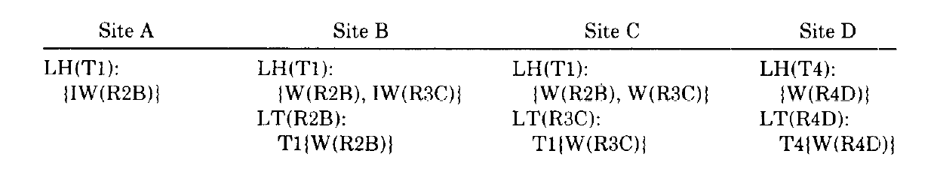
Lock Histories & Lock Table:

Slide 24
Step 1
T1 now attempts to acquire resource R4
1. An IL entry is placed in LH(T1) and in LT(R3) at site C.
2.Since there are no intention locks in LT(R3C), the WFS from site C is collected, and an agent of T1 is created at site D.
LH(T1): {W(R2B), W(R3C), IW(R4D)}.
3.Site D now applies and places the IL entry in LT(R4D) and LH(T1).
4. After the delay it executes by combining the lock histories of T1 and T4.
5.No cycles are found, but as T4 is still active at site D.
6. The algorithm stops

Slide 25
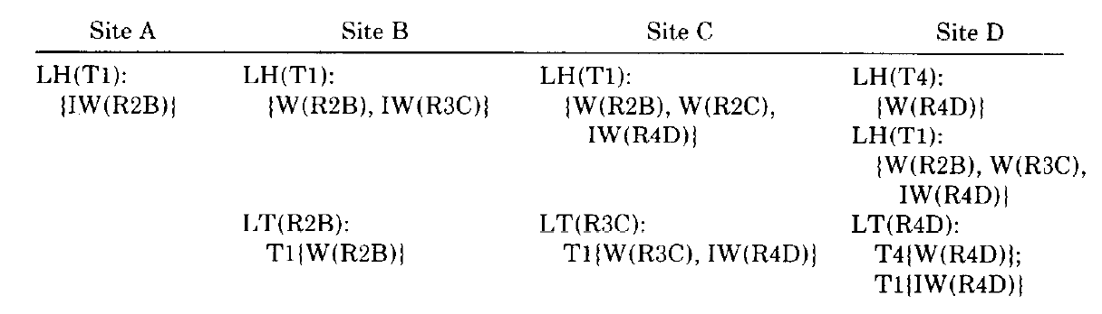
Lock Table & Lock Histories

Slide 26
Step 2:
T4 now determines that it needs to write into resource R3.
1. Places an IL entry in LH(T4) and LT(R4D).
LT(R4D): T4{W(R4D), IW(R3C)};
T1(IW(R4D)}
2. Since T1 is waiting for R4, held by T4, and T4 has made a remote type I resource R3 request,
3. T4 and T1 lock histories are combined into a WFG or a WFS.

Slide 27
Step 3:
1. The algorithm would allow T4 to create the agent at site C.
WFS T1{LH}T4{LH}.
2. After T4 places a lock at site C and deadlocks with T1.
WFS T4(LH}Tl{LH} results.
3. Algorithm detects a deadlock by combining.
T1{LH}T4{LH} and T4{LH}Tl{LH}
WFS: T1{LH}T4{LH}Tl{LH}.

Slide 28
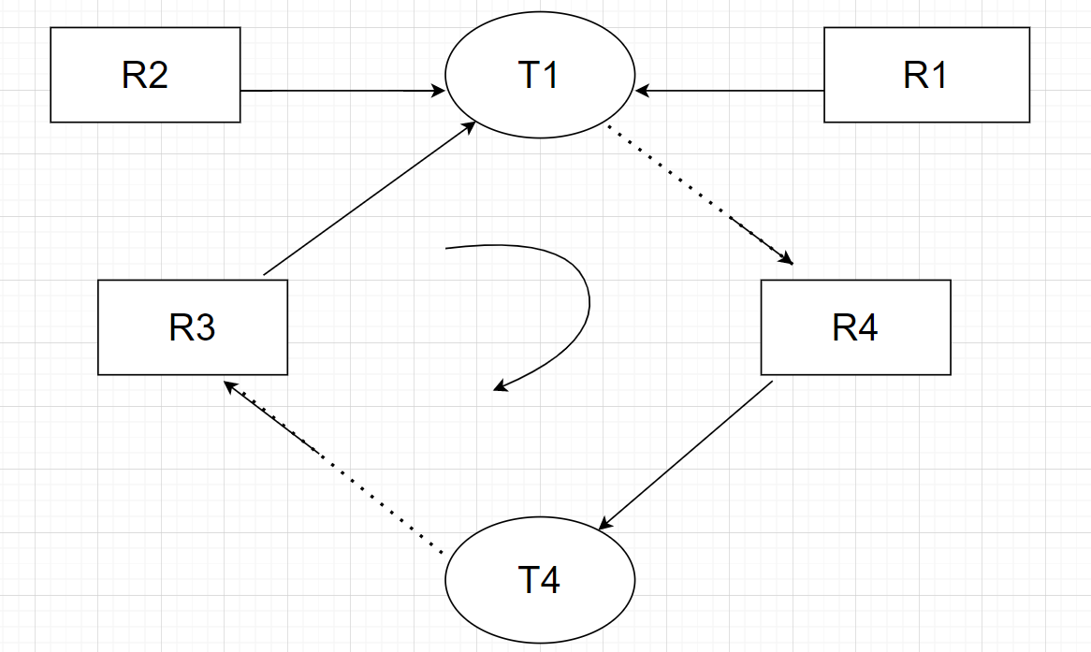
Deadlock

Slide 29
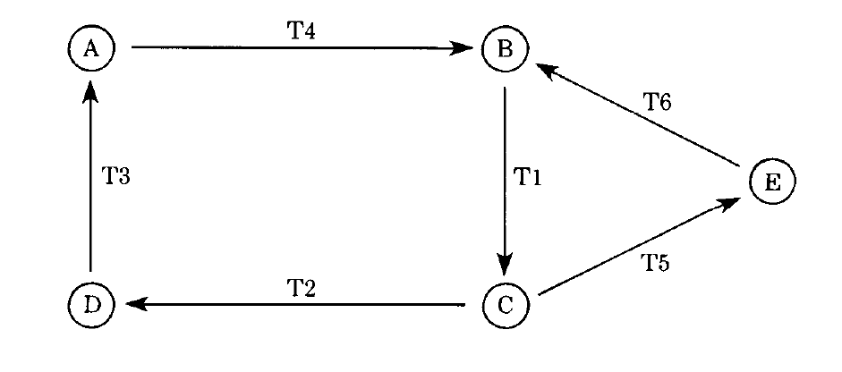
Example 2
T1 is waiting for T2 and T5 at site C, T2 is waiting for T3 at site A, T4 and T6 are waiting for T2 at
site B, and T5 is waiting for T6 at site E.

Slide 30
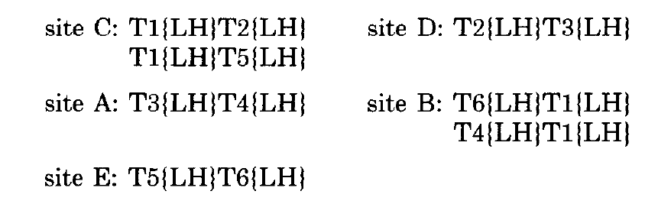
Step 1:
Level three will detect all global deadlocks as follows:
When deadlocks occur, there is the following set of WFSs at different sites:

Slide 31
Step 2:
The proposed algorithm will generate one WFS message from site B to C. When the message is received at site C, the algorithm at site C will construct the following set of new WFSs:
Since no deadlock is detected, and because T2 and T5 migrated to sites D and E.

Slide 32
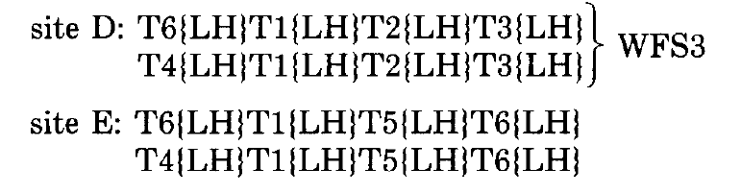
Step 3:
The algorithm will generate two wait-for messages, WFS1 and WFS2,which are then sent to sites D and E, respectively. Sites D and E, upon receiving these messages will execute and generate the following:
site E will detect and resolve a global deadlock T6T1T5T6.
At site D will generate wait-for message WFS3 and send it to site A.

Slide 33

New WFS from the lock histories of the transactions in the WFSs from other sites and from the lock histories of all blocked or inactive transactions at this site. Check for a deadlock. It is found and then the deadlock resolved.

Slide 34
Detection:
T4 T1 T2 T3 T4 Deadlock is detected and resolved.
T4 should be rolled back and re-executed after T3 finishes at site A.
Similarly,
T6T1T5T6 deadlock is detected at site E, it should be resolved by rolling back, T6 and re-executing it after T5 finishes at site E.
Clearly, if the T4 T1 T2 T3 T4 deadlock is resolved as indicated, the algorithm at site A should recognize that removing T4 from WFS5 and WFS4 will result in T3, T2, and T1 terminations. Then WFS4 is reduced to T6{LH}T4{LH} and WFS5 to T4{LH}.
By inspecting the T6 and T4 lock histories, it is easy to see that WFS T6{LH)T4(LH) is a false wait-for condition, and this WFS can be discarded.
This indicates the usefulness of LHs for detection of false deadlocks.

Slide 35
Informal Proof of Correctness
We consider 4 categories of deadlocks:
Category A: Local deadlocks in which all the resources and transactions involved in the deadlock are local.
Category B: Same as category A, with the exception that the transactions are nonlocal, that is, they may have locked resources at other sites.
Category C: All direct global deadlocks of cycle length 2 for resources of type I and all direct global deadlocks of cycle length 2 for resources of type II when transactions migrate sequentially.
Category D: Any number of transactions and resources may be directly or indirectly deadlocked at any number of sites.

Slide 36
Category A:
Step 2B(3) (level two) will combine the lock histories of all the blocked or inactive transactions at the site
This information will be a complete and accurate global snapshot of the deadlock cycle, and hence the deadlock will be detected.
Category B:
Since all the transactions involved in the deadlock are currently at this site, their lock histories are complete and accurate in so far as they pertain to the deadlock cycle.
WFGs or WFSs constructed by step 2B(3) may contain information about other locks held by the transactions involved, but the necessary information concerning the deadlock cycle will certainly be present.

Slide 37
Category C:
Simultaneous Transactions: The “next” field of the lock table of the requested resource would show an intention lock on the other resource, and this cycle would be detected by step 2.
Sequential Transactions: The second transaction would place an intention lock in the lock table of its last locked resource before it migrates.
Type 1: The level one check of step 1B would cause a WFG or a WFS to be constructed and this would reveal the deadlock cycle
Type 2: deadlocks are detected by step 2B(3).

Slide 38
Category D:
Similar to Category C
If level 2 cannot detect, level 3 sends WFS to migrated site subject to the constraints of the optimization.
Steps 3 and 4 cause this process to be continued, with each site adding additional information, until a site contains enough information to detect a deadlock cycle

Slide 39
False Deadlock Anomaly
A transaction decides to abort, but before its abort message reaches another agent of that transaction, a deadlock is found involving that transaction.
This could be considered a false deadlock, since one of the transactions involved has aborted, probably breaking the deadlock cycle
The delays introduced in steps 2B(l) and 2B(3) (c) should allow the abort message to arrive.
The proposed algorithm uses the latest copy of a transaction’s lock history to avoid false deadlock detection.

Slide 40
Performance Analysis
Intersite Messages:
Type 1: 0 to N - 1 messages ; where N=∑^{n} (n-k) messages.
k=1
Type 2: 0 to N messages
Sequential Migrations: 0 Messages
When a transaction migrates, it “brings along” all pertinent wait-for information from its current site.
Obermarck:
Type 1: 1 to N messages
Type 2:
Simultaneous Migrations: Same as proposed algorithm Sequential Migrations: Higher than proposed algorithm

Slide 41
Overhead:
The proposed algorithm minimizes the number of messages at the cost of larger messages and at the cost of doing some computation before each remote resource request.
This constant overhead consists of constructing WFSs from lock histories of all transactions . Potential Payoffs:
avoiding most frequent global deadlocks on resources of type I
avoiding sending a remote message and the creation of a remote agent
reduction of deadlock detection messages for resources of type II.

Slide 42
Conclusion
Badal’s algorithm exploits the fact that deadlocks can be divided into several categories based on the complexity of their topology; the frequency of deadlock occurrence and the costs of deadlock detection differ among categories.
The proposed algorithm has been shown to be able to detect deadlock with a smaller number of intersite messages than existing algorithms for deadlock detection in distributed computing systems.
Badal optimizes performance by using three levels of deadlock detection; activity at each level is more complex (and expensive) than at the preceding level.
It detects the most frequent deadlocks with minimum overhead (first- and second-level algorithms) and switches to an expensive algorithm (third level) only when really needed.
It has a fixed overhead due to information kept in lock tables, frequent checking of deadlocks of length two, and longer messages.
It is most suitable in environments where deadlocks occur frequently, justifying the fixed overhead.

